Slide 1
09
59
58
57
56
55
54
53
52
51
50
49
48
47
46
45
44
43
42
41
40
39
38
37
36
35
34
33
32
31
30
29
28
27
26
25
24
23
22
21
20
19
18
17
16
15
14
13
12
11
10
09
08
07
06
05
04
03
02
01
00
:
How many questions can you answer on your mini safari in 10 mins?

Slide 2
*Note* animated backgrounds may slightly delay slide transitions
08
59
58
57
56
55
54
53
52
51
50
49
48
47
46
45
44
43
42
41
40
39
38
37
36
35
34
33
32
31
30
29
28
27
26
25
24
23
22
21
20
19
18
17
16
15
14
13
12
11
10
09
08
07
06
05
04
03
02
01
00
:
Delete slide (1) for a nine minute countdown

Slide 3
*Note* animated backgrounds may slightly delay slide transitions
07
59
58
57
56
55
54
53
52
51
50
49
48
47
46
45
44
43
42
41
40
39
38
37
36
35
34
33
32
31
30
29
28
27
26
25
24
23
22
21
20
19
18
17
16
15
14
13
12
11
10
09
08
07
06
05
04
03
02
01
00
:
Delete slides (1 - 2) for a eight minute countdown

Slide 4
*Note* animated backgrounds may slightly delay slide transitions
06
59
58
57
56
55
54
53
52
51
50
49
48
47
46
45
44
43
42
41
40
39
38
37
36
35
34
33
32
31
30
29
28
27
26
25
24
23
22
21
20
19
18
17
16
15
14
13
12
11
10
09
08
07
06
05
04
03
02
01
00
:
Delete slides (1 - 3) for a seven minute countdown

Slide 5
*Note* animated backgrounds may slightly delay slide transitions
05
59
58
57
56
55
54
53
52
51
50
49
48
47
46
45
44
43
42
41
40
39
38
37
36
35
34
33
32
31
30
29
28
27
26
25
24
23
22
21
20
19
18
17
16
15
14
13
12
11
10
09
08
07
06
05
04
03
02
01
00
:
Delete slides (1 - 4) for a six minute countdown

Slide 6
*Note* animated backgrounds may slightly delay slide transitions
04
59
58
57
56
55
54
53
52
51
50
49
48
47
46
45
44
43
42
41
40
39
38
37
36
35
34
33
32
31
30
29
28
27
26
25
24
23
22
21
20
19
18
17
16
15
14
13
12
11
10
09
08
07
06
05
04
03
02
01
00
:
Delete slides (1 - 5) for a five minute countdown

Slide 7
*Note* animated backgrounds may slightly delay slide transitions
03
59
58
57
56
55
54
53
52
51
50
49
48
47
46
45
44
43
42
41
40
39
38
37
36
35
34
33
32
31
30
29
28
27
26
25
24
23
22
21
20
19
18
17
16
15
14
13
12
11
10
09
08
07
06
05
04
03
02
01
00
:
Delete slides (1 - 6) for a four minute countdown

Slide 8
*Note* animated backgrounds may slightly delay slide transitions
02
59
58
57
56
55
54
53
52
51
50
49
48
47
46
45
44
43
42
41
40
39
38
37
36
35
34
33
32
31
30
29
28
27
26
25
24
23
22
21
20
19
18
17
16
15
14
13
12
11
10
09
08
07
06
05
04
03
02
01
00
:
Delete slides (1 - 7) for a three minute countdown

Slide 9
*Note* animated backgrounds may slightly delay slide transitions
01
59
58
57
56
55
54
53
52
51
50
49
48
47
46
45
44
43
42
41
40
39
38
37
36
35
34
33
32
31
30
29
28
27
26
25
24
23
22
21
20
19
18
17
16
15
14
13
12
11
10
09
08
07
06
05
04
03
02
01
00
:
Delete slides (1 - 8) for a two minute countdown

Slide 10
*Note* animated backgrounds may slightly delay slide transitions
00
59
58
57
56
55
54
53
52
51
50
49
48
47
46
45
44
43
42
41
40
39
38
37
36
35
34
33
32
31
30
29
28
27
26
25
24
23
22
21
20
19
18
17
16
15
14
13
12
11
10
09
08
07
06
05
04
03
02
01
00
:
Welcome Back!
Delete slides (1 – 9) for a one minute countdown

Slide 11
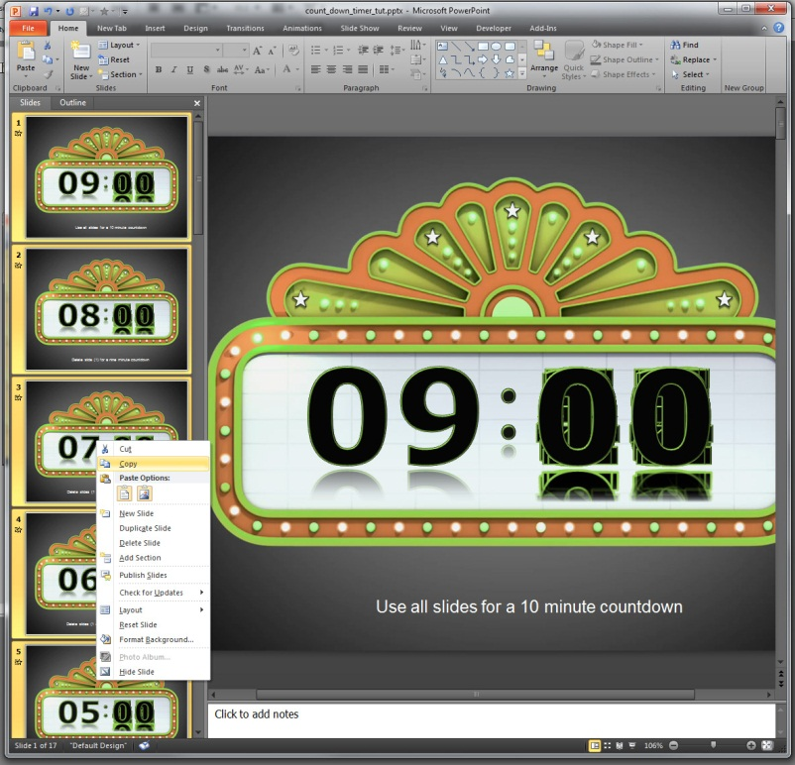
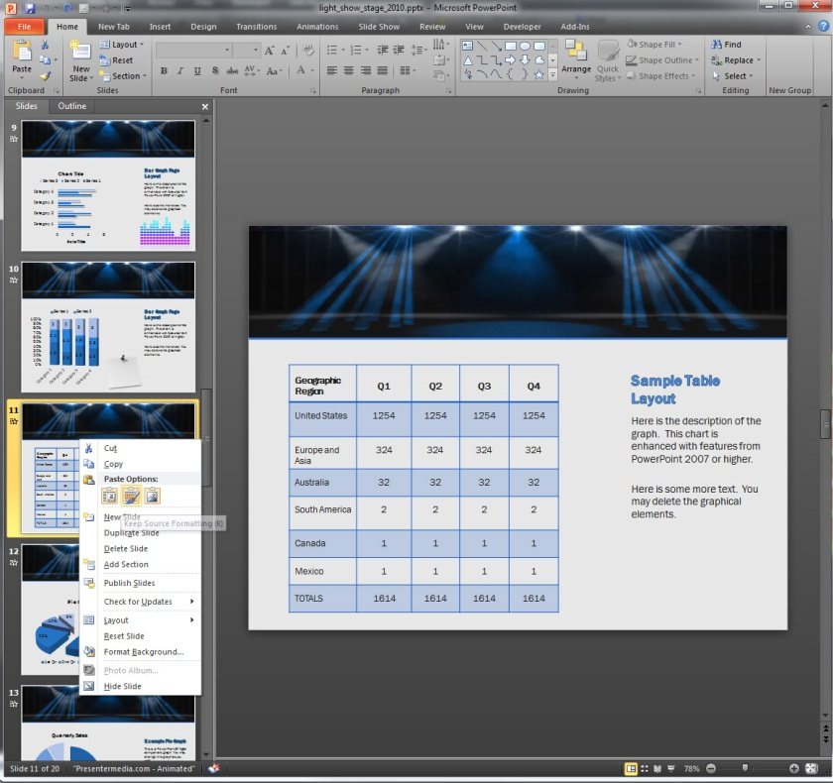
How to Copy Your Timer Countdown to Another Template.
*Start with both templates open*
Step 3. Now go to the template you want to copy the countdown slide to. Left mouse click select a slide thumbnail where you would like the slide to be inserted highlighting it in yellow.
Step 4. Right click on the selected thumbnail preview and under paste options select the one that says Keep Source Formatting. This should be the Middle one.
Step 1. Holding Shift on your keyboard left mouse click all the thumbnail slides you want to copy. When they are selected they will show up highlighted in yellow.
Step 2. Now right mouse click on any of the highlighted thumbnail slides and select copy.
*NOTE* To use the layout from the template you are copying to, select the first paste option. Use destination Theme *

Slide 12
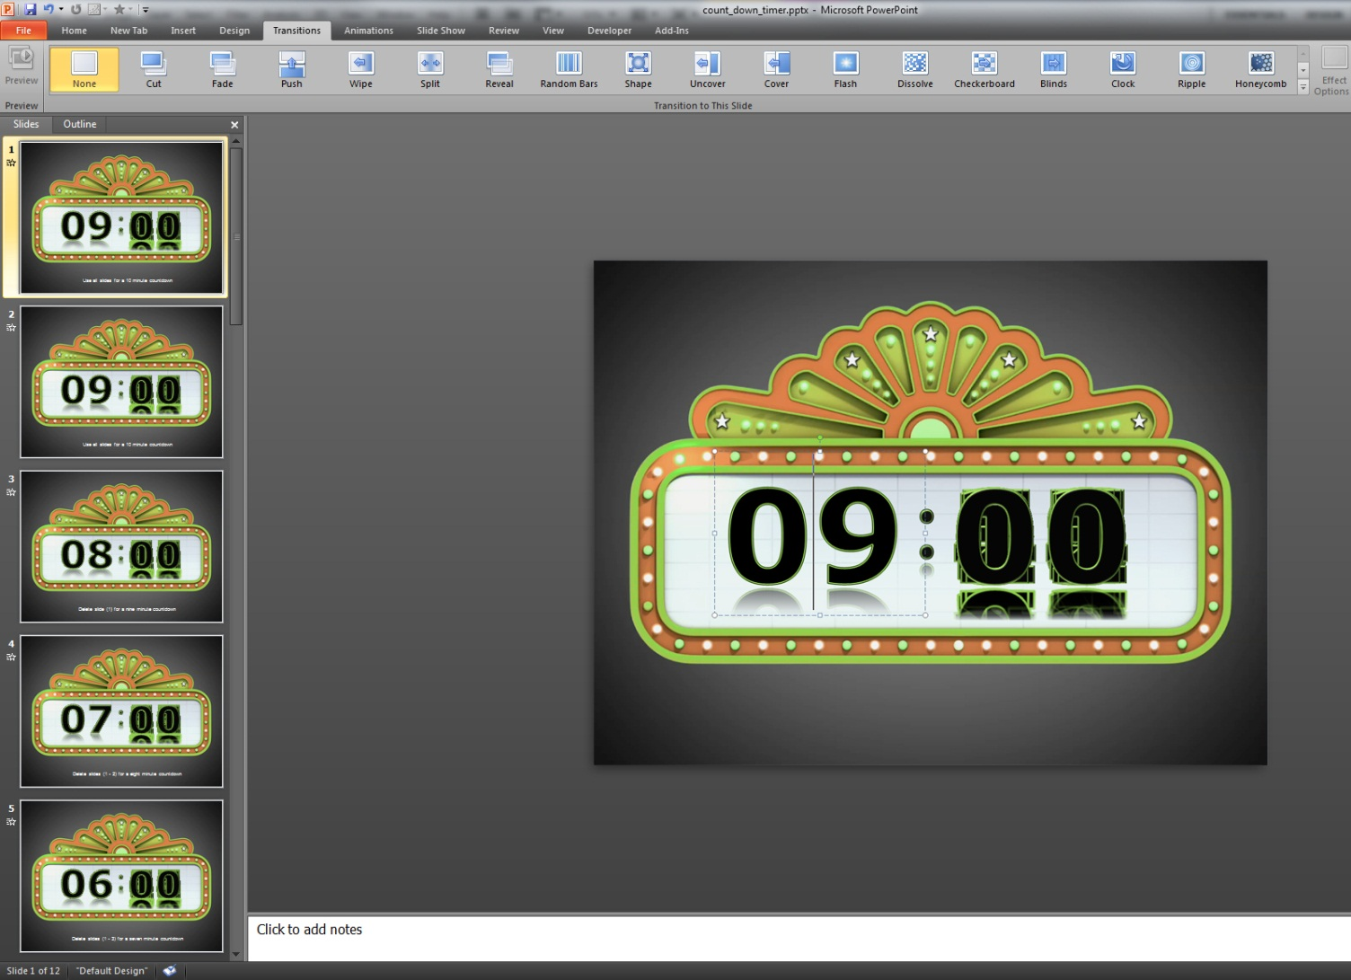
Adding Minutes to your Counter Timer
Step 2. Select your new slide by click it with right mouse button. You will know it is selected by the yellow highlight around the thumbnail preview.
Step 3. Left click this text box to change the minute of this this slide.
Step 4. Now type in the new minute number to count down from on this slide. *you will not actually see this small thumbnail pop-up.
Step 5. Repeat steps for desired number of minutes.
Step 1. Add a new slide by right clicking on a n existing slide thumbnail and selecting Duplicate Slide from the drop down menu. A new duplicate slide will then be created.

Slide 13
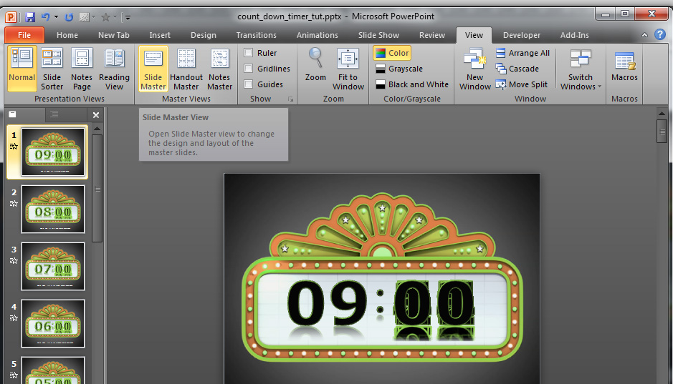
Normal Mode Explained
When you first open PowerPoint you will be viewing your thumbnail previews and work area in Normal View. This is the view you will always use to show your presentation in. You will know you are in normal mode if it is selected in under your view tab.
Adding and changing background layouts in the Slide Master.
Step 1. Select the view tab.
Click to Slide Master button to open the slide master.
Slide Master Mode Explained
The heart of a PowerPoint template is the Slide Master. To view the slide master – choose View>Slide Master.
Slide Master View in PowerPoint
controls all the default layouts and various pre-designed slides that are included in our templates. Each Slide Master can have any number of layout pages beneath it. Think of the Slide Master as a unseen main template layout running in the background of your normal template. In normal view you can then choose from various layouts stored in the unseen master slide.
Go to next slide to view second Part.

Slide 14
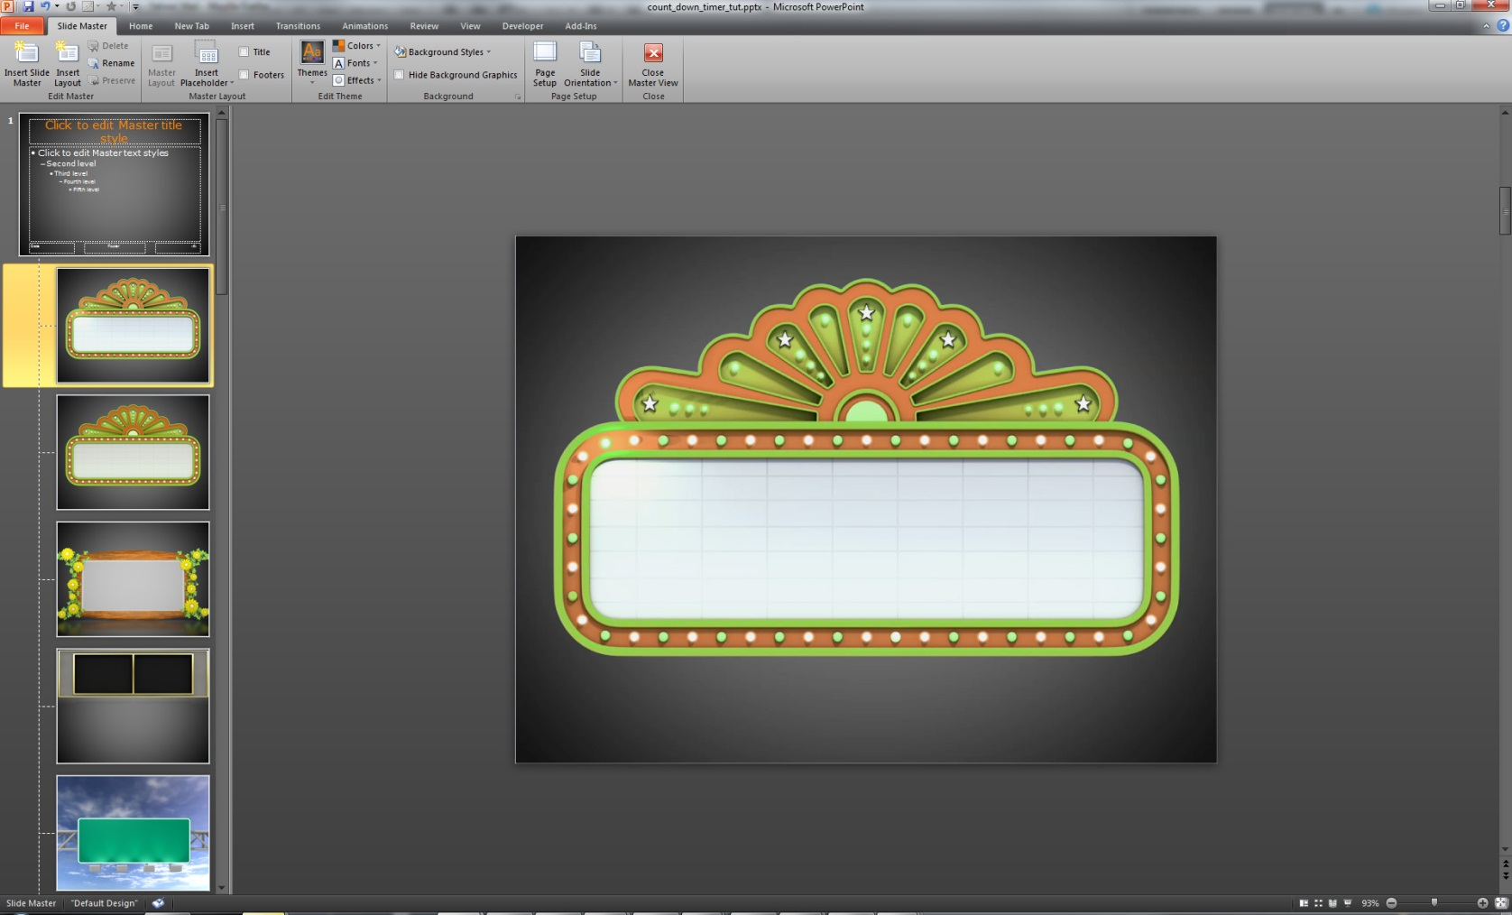
Adding and changing background layouts in the Slide Master – Second Part.
Your in Slide Master View .
Changing the back ground of this top Master Slide will change all slides underneath it. Leave this slide for now.
*note- changing text in Slide Master will not change it inside normal view. Slide master is for layout purposes only.
Closing Master View Mode.
To exit slide master mode simply click on the little red x under
Slide master tab and PowerPoint will return to Normal View Mode.
Layout Pages.
You can change the background or images in these layout slides and select from them in normal mode. There are already a list of pre-designed slide layouts or you can add new ones to choose from.
Adding New Layout Slide:
Add a new slide layout by left clicking a existing slide thumbnail and choosing Insert Layout from the drop down menu. You can now add your own images to this Layout slide.
Go to next slide to view third Part.

Slide 15
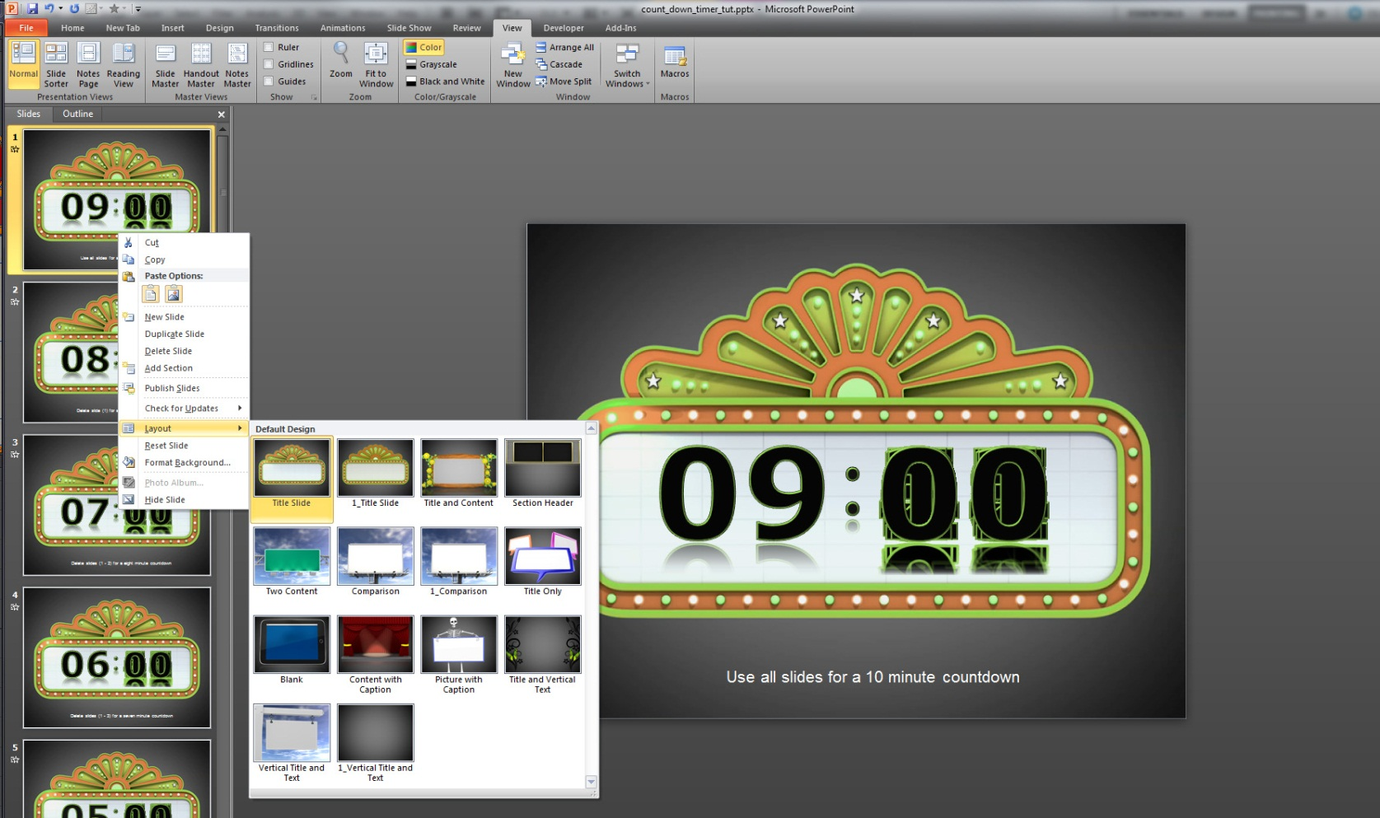
Adding and changing background layouts in the Slide Master – Third Part.
Back to Normal View:
You should now be back in Normal View Mode indicated in yellow highlight under the view tab.
Selecting from Your Slide Master Layouts:
In normal view you can now select your layout slide you want to use.
Do this by Left Clicking on the slide thumbnail in on the left and selecting Layout from the Drop Down Menu. Then you will have a window that will give you a Preview Window of all your layout slide from your Slide Master, which is unseen and running in the background.
*note- you can change multiple slides at once by holding shift and left mouse clicking multiple slide thumbnails.

Slide 16
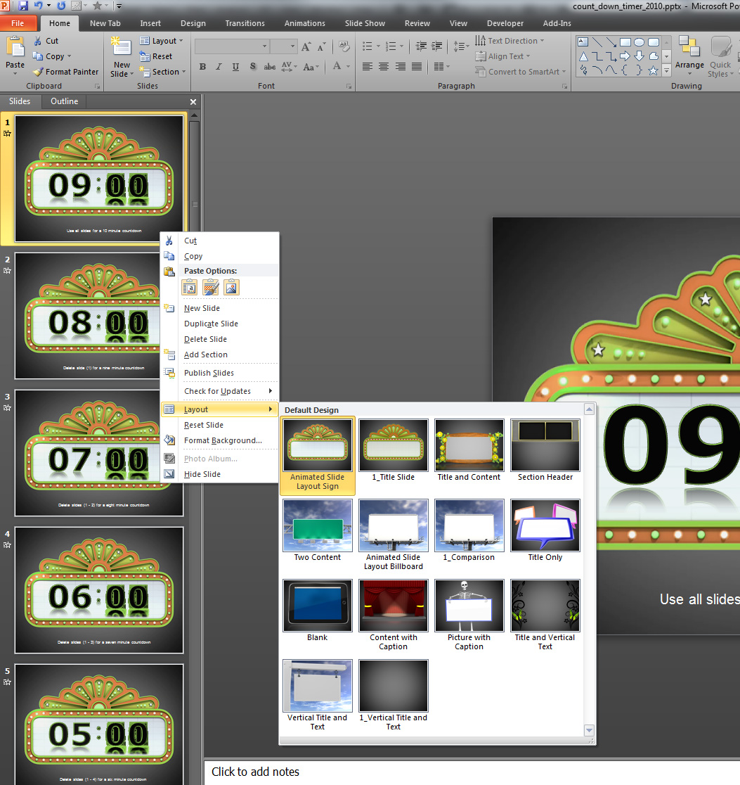
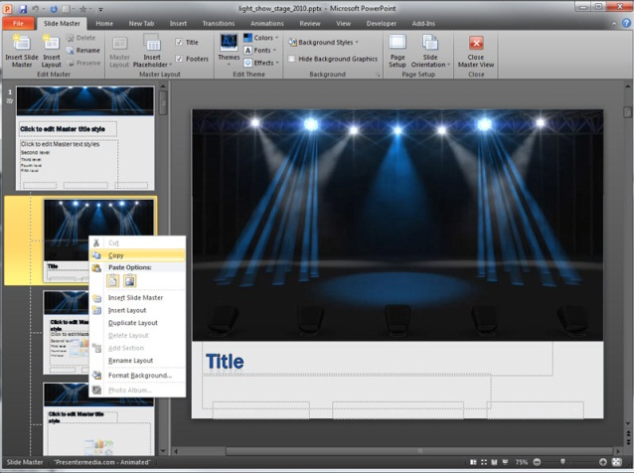
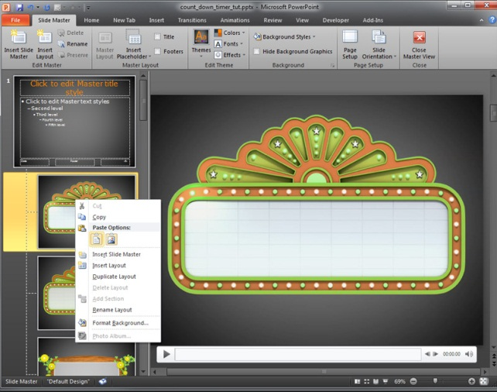
Adding Slides from other templates.
This Template Contains Two Animated Slides to Choose from and eleven static slides.
Open both the template you want to copy from and the one you want to copy to.
In the Slide Master View left click a thumbnail you want to copy. From the drop down menu select Copy.
Go to other template and in Slide Master View left click on slide thumbnail and select the first paste option, Use Destination Theme.

